Slide 1
Extended Loop Control
Notes:
Hi, in this video we’re going to learn about how we can further control the value of i in for loops.

Slide 2
Value of i in For Loops
for i in range(ending_num):
Notes:
We know that the value of i is counting from 0 to an ending value by 1, but can we alter this? Yes!

Slide 3
More Control over the Value of i
for i in range(starting_num, ending_num, increase_by):
We can further control the value of i by using more parameters:
Starting number
Ending number
Amount to increase by
Notes:
We can have even more control over the value of i by using more parameters. If we just put one value in for our range, Tracy will default to starting at 0 and counting by 1 up to that value.
But if we want the values of i to increase another way or start at a value other than 0, we can plug these numbers in. The first value we enter is the starting number, followed by the ending value, and then the amount to increase by on each iteration. Let’s take a look at an example using these extended parameters.

Slide 4
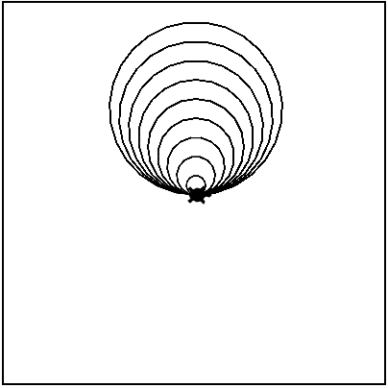

More Parameters for i
The value of i is starting at 10 and increasing by 10 until it reaches 100 when it stops.
*Does not include i = 100!
Notes:
This code is creating a loop where i starts at 10, goes up to 100, and increases by 10 each time. The value of i is controlling the radius of the circles being drawn.
So the first circle Tracy draws has a radius of 10, and then i increases by 10 and becomes 20. The value of i keeps increasing this way (10, 20, 30, 40…) until it reaches 100 when it ends. 100 is not included in our loop so if we wanted our final circle to have a radius of 100...

Slide 5
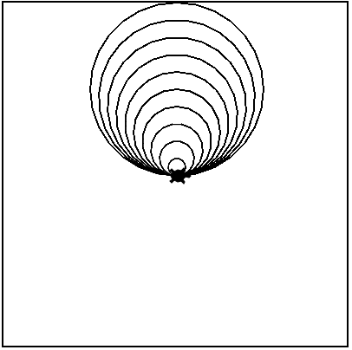

More Parameters for i
The value of i is starting at 10 and increasing by 10 until it reaches 101 when it stops.
Notes:
...We’d need to make the ending value greater than 100.

Slide 6


How Can We Use the Value of i?
The value of i is starting at 0 and increasing by 1 until it reaches 5 when it stops.
Notes:
Let’s look at one more example.
Here, i is starting at 0 and counting up to 5. We are using i in our code to control the radius of our shape. We are using the extended parameters for the circle command so Tracy will actually be drawing squares, because we’ve entered 4 for the number of points.
But when we run this code, it looks like nothing happened. Well, our value of i is starting at 0, so we’re first having Tracy draw a square with a radius of 0, which will be nothing. Then our radius is increasing to 1, but a square with sides of 1 pixel are too small for us to see with Tracy in the way. The radius value is increasing until it reaches 5 but that’s still too small to see. How can we change this code so she draws shapes we can see?

Slide 7
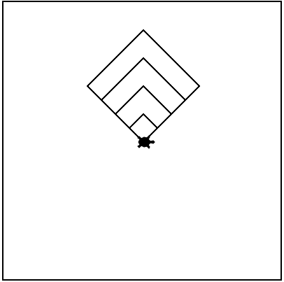

How Can We Use the Value of i?
The value of i is starting at 0 and increasing by 1 until it reaches 5 when it stops.
i = 4
i = 3
i = 2
*Does not include i = 5!
i = 1
i = 0
Notes:
Well, we have two options. (Click for labels) The first thing we could do is use a mathematical expression to increase the value of i by 20 each iteration.

Slide 8

How Can We Use the Value of i?
The value of i is starting at 20 and increasing by 20 until it reaches 81 when it stops.
i = 80
i = 60
i = 40
i = 20
Notes:
Or we could (Click for labels) alter the value of i by using our extended parameters! Let’s take a look at using extended parameters in our Tracy programs.

Slide 9
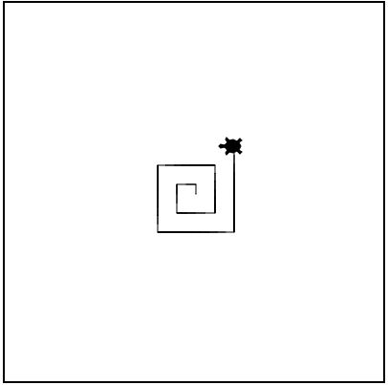
Example #1: Square Swirl
Write a program that has Tracy draw a square swirl where she moves 10 pixels further every time she turns left. Have Tracy move forward and turn 10 times.
Notes:
In this example, we want to have Tracy draw a square-shaped swirl where she moves 10 pixels farther after she turns left for 10 repetitions.

Slide 10
Commands Learned this Lesson
Command | What does it do?
for i in range(starting_num, ending_num, increase_by): | Alters the value of i by including a starting value, ending value, and a value to increase by on each iteration
Notes:
In this lesson, we learned how to alter the value of i even further. Look back at the examples we completed to help you solve the next set of Tracy challenges!

